Slide 1
James Chapters 3 & 4
Thursday Morning Bible Class
Our Redeemer Lutheran Church
Wauwatosa, WI

Slide 2
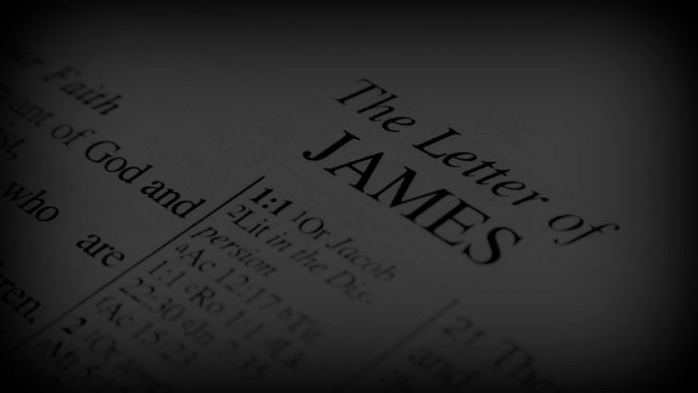
Taming the Tongue – 3:1-12
Chapter 3 is an extended discussion on the distressing power of the tongue, followed by a call to use the tongue to teach wisdom.
1 – James treats teaching as an office in the church. The admonition is for those who teach the faith.

Slide 3
Taming the Tongue – 3:1-12
2 – We all stumble – no one can avoid sin, but the most difficult thing to control is the tongue. If one can control the tongue, you can control your whole body.
Illustration: the bit in the mouth of the horse will control the horse.
Illustration: a small rudder controls a ship.

Slide 4
Taming the Tongue – 3:1-12
5 – In the same way, the small tongue can cause a great calamity.
6 – The tongue is a fire that can bring about a world of evil.
7-8 – We can tame all sorts of wild creatures, but no one can tame the tongue.
The irony of the tongue – It can be used to bless God and curse others.

Slide 5
Taming the Tongue – 3:1-12
11 – No where else in nature can you find such a thing.
12 – A fig tree does not bear olives; a grape vine does not produce figs; salt water does not produce fresh water.
We should use our tongue to pray, praise and give thanks.

Slide 6
Taming the Tongue – 3:1-12
13 – Having told teachers how to talk, he now speaks about how they should live.
Wisdom is not mere head knowledge, but is shows in our conduct.
Those who do good works to bring attention to themselves show they lack true wisdom.

Slide 7
Taming the Tongue – 3:1-12
14 – “bitter jealousy and selfish ambition” are the opposite of the “meekness of wisdom.” Such a person should not deceive themselves about how wise they are.
15 – Their wisdom is more like the world, the flesh and the devil.

Slide 8
Taming the Tongue – 3:1-12
16 – The fruit of human, earthly wisdom is confusion and every evil thing.
17 – The wisdom that comes from God:
Pure – the absence of a sinful motive.
Peaceable – like God who is gentle and kind.
Gentle – Who knows how to forgive
Willing to yield – not stubborn or obstinate.

Slide 9
Taming the Tongue – 3:1-12
17 – The wisdom that comes from God:
Full of mercy – Does not judge others strictly on the basis of the law, but will offer mercy.
Full of good fruits – This wisdom can be seen by the fruit it produces.
Without partiality – without pre-judging
Without hypocrisy – without pretending to be what it is not.

Slide 10
Warning against Worldliness – 4:1-12
1 – The cause of fights among Christians? The internal war in every believer with the lusts of the flesh.
2 – Covetousness leads to conflict.
3 – The problem: We do not seek God for our needs. The power of prayer is ours, but we pray with selfish motives.

Slide 11
Warning against Worldliness – 4:1-12
4 – Here is our real problem: adultery (idolatry). When we, who profess loyalty to God yet chase after other gods we demonstrate our adultery (idolatry).
Either we are friends with God or friends with the world.

Slide 12
Warning against Worldliness – 4:1-12
5 – A verse very difficult to translate. Either:
God is jealously yearning for the devotion of our spirit which he put in us; or
The Spirit within us jealously yearns for the full devotion of our heart to God.
6 – The Holy Spirit will give us the grace to serve God as we should.

Slide 13
Warning against Worldliness – 4:1-12
6 – God “resists the proud but gives grace to the humble.” God’s grace is for all, but only the humble—the repentant—recognize God’s grace is there for him.
God’s grace is always greater than the sin we pile up.

Slide 14
Warning against Worldliness – 4:1-12
7 – James calls on us to have friendship with God rather than with the world. Repentant citizens of God’s kingdom are able to resist the devil. If we do, he will flee from us.
8-9 – The only way to resist the devil is by being near to God. James is calling for an attitude of repentance.

Slide 15
Warning against Worldliness – 4:1-12
8-9 – What does repentance look like?
Cleanse your hands
Purify your hearts so that you are not double-minded: trying to serve two masters.
We “lament, mourn and weep” – the anguish of repentance.

Slide 16
Warning against Worldliness – 4:1-12
10 – When we come as sinners before God, we humble ourselves before him and He will lift us up.
11 – Again a caution about using the tongue: do not “speak evil” (slander). We are speaking of a brother – a fellow believer.
12- There is only one Lawgiver – and it’s not us!

Slide 17
Boasting about Tomorrow – 4:13-17
13 – Our life and endeavors are all conditional – we do no know what tomorrow will bring.
14 – James is not telling us not to plan, but to always remember that God will ultimately plan tomorrow.
Life is but a mist – chevel – here briefly and then gone. (Ecclesiastes!)

Slide 18
Boasting about Tomorrow – 4:13-17
15 – Make your plans, but it is always “as the Lord wills.”
16 – Pursuing riches without God is prideful arrogance.
17 – The uncertainty of life should make us ready to recognize what is good and then do it.

